Slide 1

Crop Yield Prediction in India
By: - Rishabh Awasthy

Slide 2
Targeted Problem: - The targeted problem is to predict crop yields per acre of rice or wheat crops in India, The goal is to provide accurate crop yield predictions to empower these farmers and alleviate poverty and malnutrition.
Research Question: -
Can we predict crop yield per acre, using data on farming practices and environmental conditions?
Dataset: -
Source: The dataset used for this project is collected by Digital Green through surveys conducted among smallholder farmers in India. The data includes information on farming practices, environmental conditions, crop types (rice or wheat), and historical crop yields. Dataset link: https://zindi.africa/competitions/digital-green-crop-yield-estimate-challenge/data
Short Description: The dataset is designed to capture the specific challenges and conditions faced by smallholder farmers in India. It provides valuable insights into the factors influencing crop yields and allows for a targeted approach to predicting rice and wheat crop yields per acre.
Size: The dataset is substantial, covering a significant number of smallholder farmers over multiple agricultural seasons. It encompasses a diverse range of features, allowing for a comprehensive analysis.
Motivation: -
Technical Motivation: The development of a crop yield prediction model tailored to smallholder farmers in India represents an opportunity to apply machine learning and data science for social impact. It involves addressing real-world challenges by harnessing data to improve the livelihoods of vulnerable populations.
Personal Motivation: The prospect of contributing to breaking the cycle of poverty and malnutrition among smallholder farmers in India is a compelling motivation. This project offers a chance to make a tangible difference in the lives of these farmers and advance global food security in a meaningful and impactful way.

Slide 3


Slide 4
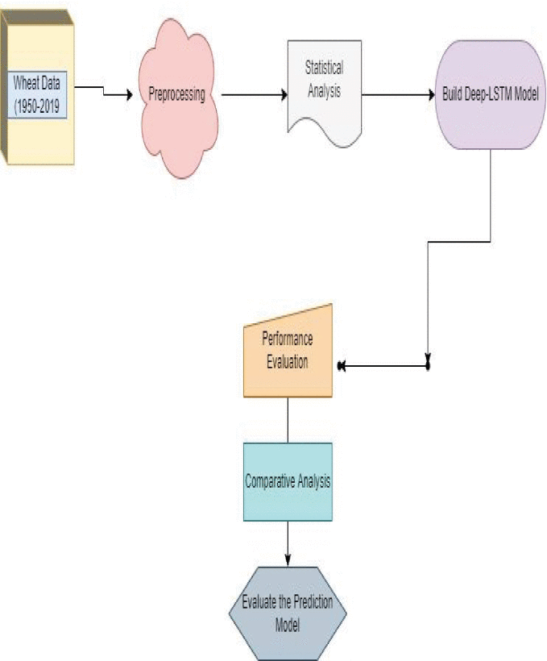
Deep-LSTM Model for Wheat Crop Yield Prediction in India By: - Preeti Saini; Bharti Nagpal
Article Link : - https://ieeexplore.ieee.org/document/9913604
Goal: - The Article focuses on the Yield prediction of Wheat Crops in India using a Deep-LSTM model, where results were evaluated using Root Mean Square Error, and Mean Square Error and Compared with the existing machine learning methods.
Dataset: - Dataset was collected from the Directorate of Economics and Statistics for the 1950-2019 years.
Methodology: - The LSTM architecture includes three gates to process the input to the output stage.
Forget Gate : Initially, this gate decides which data in the sequence is to forget and retain with the network in the form of [0,1].
Input Gate : In the next step, the input gate decides which new information needs to be added to the network.
Output Gate : At this gate, decide the new hidden state of the Cell using the Sigmoid activation function
Result: - The results conclude that the proposed model outperforms the existing GPR and Holt-Winter methods with a lower RMSE Value of 0.20, 0. 51 & 0.61 respectively.

Slide 5
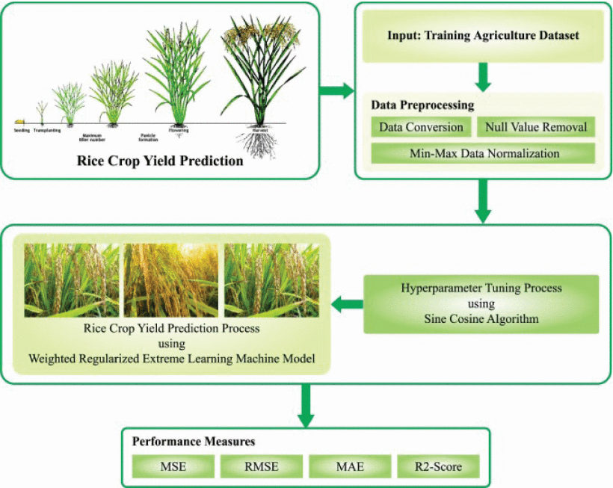
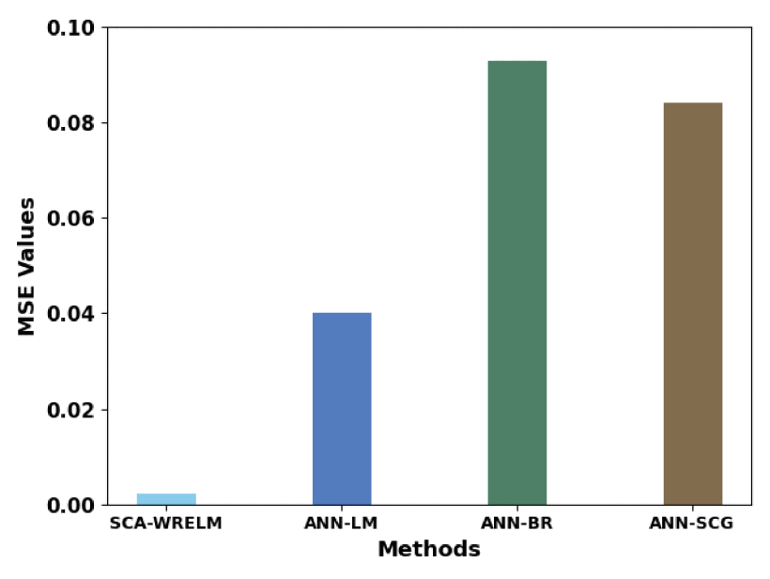
Automated Rice Crop Yield Prediction using Sine Cosine Algorithm with Weighted Regularized Extreme Learning Machine
By: - S. Thirumal; R. Latha
Article link: - https://ieeexplore.ieee.org/document/10142403/
Goal: - Proposed SCA-WRELM technique aims to forecast the rice crop productivity effectually. To do this, the SCA-WRELM technique performs min-max data normalization process to scale the data into uniform format. For yield prediction, the SCA-WRELM technique uses WRELM model to forecast the rice productivity. Finally, the SCA is exploited for the optimal parameter tuning of the WRELM model and it results in improved predictive results.
Dataset: - Using previous SCA-Wrelm dataset
Methodology: - The SCA-WRELM technique uses WRELM model to forecast the rice productivity. Huang developed the ELM, it is a kind of SLFN [16]. In ELM, the fundamental concept was that weights in-between hidden and input layers were made arbitrarily rather than iterative computation method, and weights between output and hidden layers (HLs) were calculated in least square model.
Result: - The simulation values of the SCA-WRELM approach is tested on rice yield dataset and the outcomes demonstrate the improved outcomes of the SCA-WRELM approach over other existing methods.

Slide 6
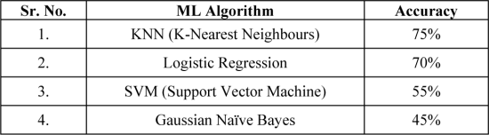
Optimizing Crop Yield in Agriculture using Data Mining and Machine Learning Techniques
By: - Rashmi Welekar, Charanjeet Dadiyala
Article link: - https://ieeexplore.ieee.org/document/10170493
Goal : - The use of data mining and machine learning techniques can aid in predicting the most suitable crops to cultivate based on a variety of factors such as soil, weather, and nutrient conditions.
Dataset: - The dataset collected was from various sources namely:
https://www.kaggle.com/
https://plants.usda.gov/npk/main
https://www.cropnutrition.com/nutrient-knowledge
https://soilhealth.dac.gov.in/
Methodology: - This project focuses on analyzing agricultural conditions and scenarios to find optimal parameters and data to maximize crop yield using data mining and machine learning techniques like k-Nearest Neighbors (k-NN), Naïve Bayes, Support Vector Machine (SVM), Linear Regression, etc. By mining crop, nutrient, soil, location, and climatic data and analyzing new, non-experimental data, the project aims to optimize yield and production, and make the agricultural sector more resilient to climatic change. Result: - The research is a helpful instrument for farmers and governments to forecast crop yields and make wise choices regarding agricultural practises.

Slide 7
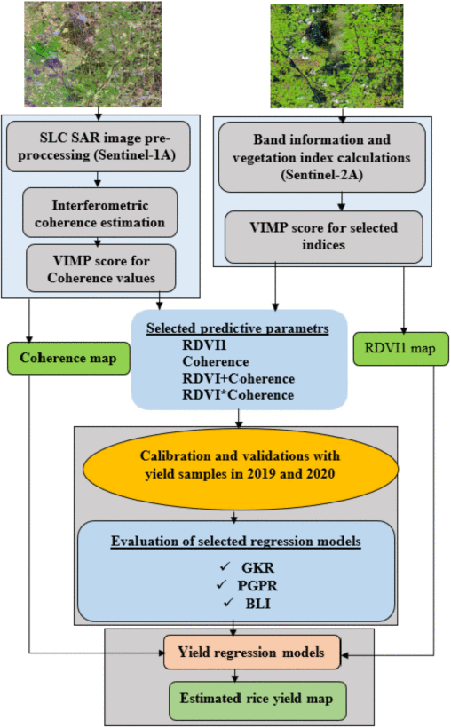
Estimation of Crop Yield From Combined Optical and SAR Imagery Using Gaussian Kernel Regression
By: - Yeshanbele Alebele; Wenhui Wang; Weiguo Yu; Xue Zhang; Xia Yao; Yongchao Tian; Yan Zhu
Article link : - https://ieeexplore.ieee.org/document/9565348
Goal : - Objective was to investigate the synergetic use of Sentinel-2 vegetation indices and Sentinel-1 interferometric coherence data through Gaussian kernel regression for estimating rice grain yield.
Dataset: - Data from the European radar C-band imaging system
Methodology: - introduced two Gaussian-based regression approaches, Gaussian kernel regression based on kernel values as weighing functions, and PGPR based on MCMC sampling. The two Gaussian-based approaches were compared with their linear extension, Bayesian linear inference regression to relate SAR and optical derived metrics with field-measured crop yield.
Result: - This study investigated the capacity of interferometric coherence to complement the information from optical data. From the piecewise linear estimation of variable importance, the best score was observed at the heading stage (RDVI1 45% and interferometric coherence_VH 44%) and used as input for the regression models.

Slide 8
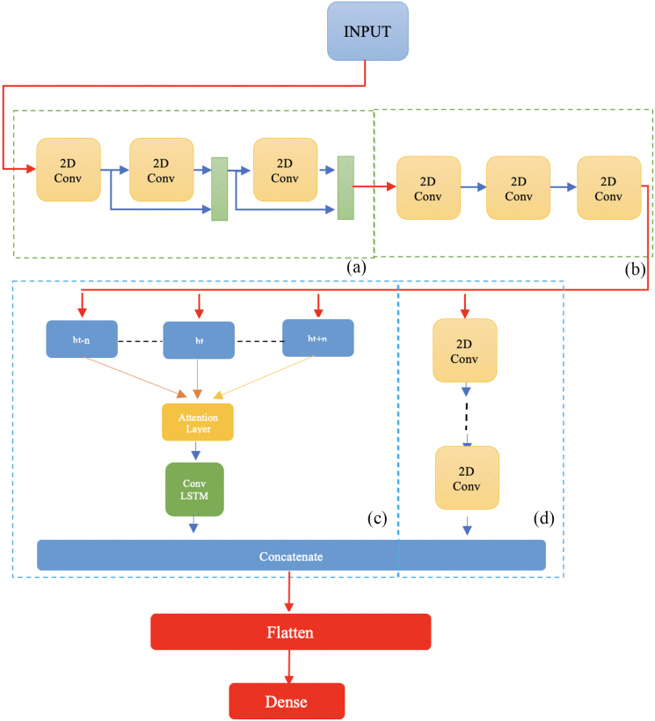
Multispectral Crop Yield Prediction Using 3D-Convolutional Neural Networks and Attention Convolutional LSTM Approaches
By: - Seyed Mahdi Mirhoseini Nejad; Dariush Abbasi-Moghadam; Alireza Sharifi; Nizom Farmonov;
Article Link :- https://ieeexplore.ieee.org/document/9956008
Goal: - This study proposed two architecture. The first model includes 2D-CNN, skip connections, and LSTM-Attentions. The second model comprises 3D-CNN, skip connections, and ConvLSTM Attention
Dataset: - MODIS-Land-surface from 2003 to 2018
Methodology: - Two novel methods have been proposed by this article, which are the combination of the 2D-CNN and LSTM attention as the first model, and the usage of 3D-CNN and ConvLSTM instated of 2D-CNN and single LSTM as the second model for county-level crop yield prediction. As the first step, multi-2D-CNNs are used with help of the skip connection to extract features. After that, the outputs of the previous step are used for attention LSTM and multicascaded CNN parallelly.
Result: - It is found that a model with three layers of CNN is the most effective forecasting system. Both proposed models have been evaluated with relevant works, including DeepYeild, ConvLSTM, 3D-CNN, and CNN-LSTM, which are tested from 2016 to 2018 in the identical conditions to have a fair comparison. It is finally discovered that the second proposed model achieved the highest score in comparison with the other methods.

Slide 9
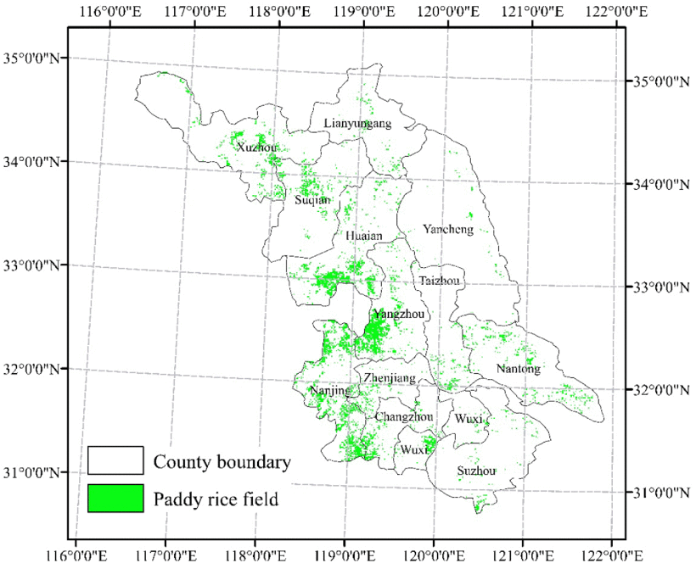
Rice Yield Estimation Based on an NPP Model With a Changing Harvest Index
By: - Fumin Wang; Feilong Wang; Jinghui Hu; Lili Xie; Xiaoping Yao
Article Link: - https://ieeexplore.ieee.org/document/9103206
Goal: - Developed an NPP-based rice yield estimation model with HI being a changing parameter.
Dataset: - Jiangsu meteorological bureau & China Meteorological Forcing Dataset
Methodology: - Developed a method for rice yield estimation with an NPP model and a changing HI. Through the NPP model, the rice yield of Jiangsu Province from 2004 to 2014 were obtained with a fixed HI first. However, the overestimation and underestimation of rice yield constantly occur, and the overall estimation accuracy is low. Since a linear increasing trend in the HI was observed, a changing HI was then considered in the NPP model. The evaluation shown that by incorporating the linearly changing HI, the proportion of the relative errors within ±5% is 1.64 times more than those obtained with a fixed HI.
Result: - The conclusion convinced that the improved NPP model with a changing HI can be a powerful method for rice yield estimation by satellite remote sensing.

Slide 10
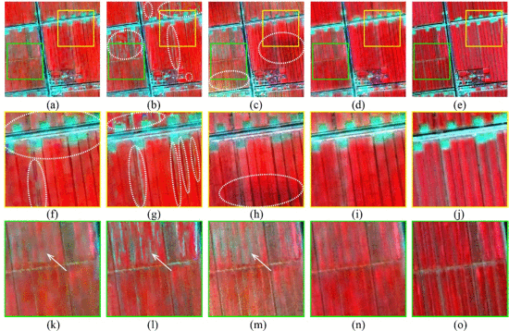
Spatiotemporal Image Fusion Method for High-Resolution Monitoring of Crops at the Subfield Level
By: - Jiale Jiang; Qiaofeng Zhang; Xia Yao; Yongchao Tian; Yan Zhu; Weixing Cao; Tao Cheng
Article Link: - https://ieeexplore.ieee.org/document/9165877
Goal : -Satellite-based time-series crop monitoring at the subfield level for the efficient implementation of precision crop management.
Data set: - One from real Gaofen-1 (GF-1) and simulated Landsat-like/Sentinel-like images, and the other from real GF-1 and real Landsat/Sentinel-2 data on two sites.
Methodology: - This study proposed a high-resolution spatiotemporal image fusion method (HISTIF) consisting of filtering for cross-scale spatial matching (FCSM) and multiplicative modulation of temporal change (MMTC). In FCSM, we considered both point spread function effect and geo-registration errors between fine and coarse resolution images. Subsequently, MMTC used pixel-based multiplicative factors to estimate the temporal change between reference and prediction dates without image classification.
Result: - The results demonstrated that HISTIF produced substantial reduction in the fusion error from cross-scale spatial mismatch and accurate reconstruction in spatial details within fields, regardless of simulated or real data. The images predicted by STARFM exhibited pronounced blocky artifacts. While the images predicted by HISTIF and Fit-FC both showed clear within-field variability patterns

Slide 11
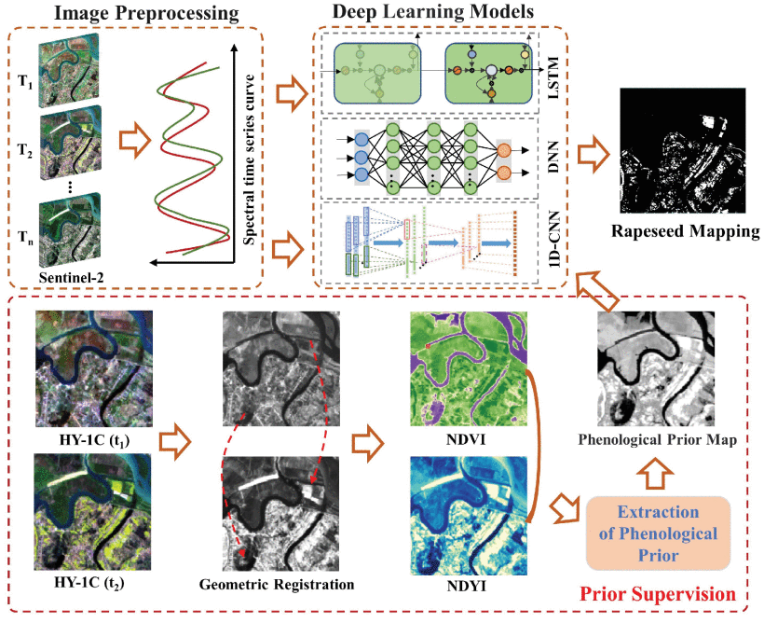
PPCE: A Practical Loss for Crop Mapping Using Phenological Prior
By: - Bin Yang; Jinyuan Guo; Jianqiang Liu; Xin Ye
Article Link: - https://ieeexplore.ieee.org/document/9991949
Goal: - Proposes a crop phenological prior cross entropy loss (PPCE) function, which focuses on guiding the training processing in the direction where crops can be better identified.
Dataset: - Data of a particular city named Changde city, China is used in this research
Methodology: - This letter proposes a novel loss function called PPCE loss to improve the rapeseed mapping performance using time series images. It involves rapeseed phenological prior, which is described by NDYI and NDVI, to quantify the prior probability of a pixel being rapeseed. The phenological prior helps to train the network in the direction where rapeseed pixels can be accurately distinguished from other pixels.
Result: - It provides a new tool for the supervision of deep learning models to improve the accuracy of crop mapping. The experimental results compared with five widely used loss functions over three typical study areas using three widely used deep learning models indicate the superior performance of PPCE loss for rapeseed mapping.

